Slide 1
KERBEROS AUTHENTICATION
21522797 – LÊ HUỲNH QUANG VŨ

Slide 2
01
Overview

Slide 3
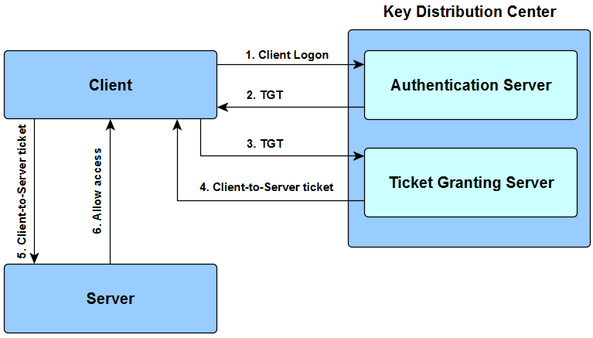
How Kerberos Authentication Works

Slide 4
02
Explanation

Slide 6
The user enters the login and password.
The cleartext user ID goes to the Authentication Server (AS) with a request for services on behalf of the user.

Slide 7

AS checks if the user login is in the database
If there is information about that user, then AS can generate a client secret key according to the user’s ID and password

Slide 8
AS sends to user:
The client/TSG session key (encrypted with the client secret key)
TGT including the user ID, network address and ticket validity period + Client/TGS session key (encrypted with the TGS secret key).

Slide 9
The client sends message to the TGS:
The TGT received from AS + Server ID + TGS/Client secret key (encrypted with the TGS secret key);
The authenticator including the client ID and timestamp (encrypted with the Client/TSG session key).

Slide 10
The TSG sends to the user:
The used ID, network address, ticket validation period + Client/Server session key (encrypted with the Server secret key);
The client/server session key (encrypted with the Client/TGS secret key).

Slide 11
The client sends the following to the Server which it tries to get access to:
The used ID, network address, ticket validation period + Client/Server session key (encrypted with encrypted with Server secret key);
The authenticator including the ID and timestamp (encrypted with the Client/Server session key).

Slide 12
The targeted server decrypts user’s messages, checks if the User ID from the both messages have the same value and if the validity period is not exceeded, then sends to the client the following parameter to confirm its identity:
Timestamp + 1 (encrypted with the Client/Server session key).
The client checks if the timestamp value is timestamp + 1, which shows the true identity of the server. If it is so, the client can trust the server and start working with it.

Slide 13
THANKS FOR LISTENING

